Slide 1
Classes, Objects, and Memory

Slide 2
Memory Allocation
When a class is declared, memory is not allocated to the data member of the class.
Class exists as a template, but data members cannot be manipulated unless an instance of this class is created by defining an object.
When an object is created, memory is allocated only to its data members but not to member functions.

Slide 3
Memory Allocation
Member functions are created and stored in memory only once when a class specification is declared.
All objects of that class have access to the same area in the memory where the member functions are stored.
However, separate storage is allocated for every object’s data members since they contain different values.

Slide 4
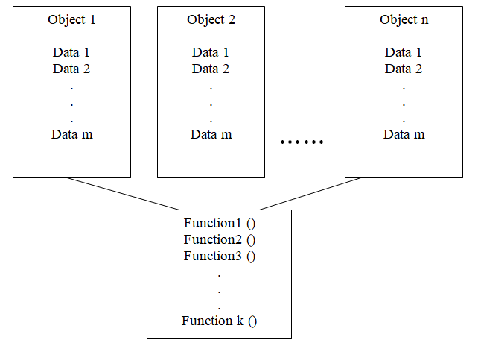
Memory Allocation

Slide 5
Static Data as class member
When a class is instantiated, memory is allocated to the created object.
However, Storage space for the data members which are declared as static is allocated by once during the class declaration.
All the objects of this class have access to this data member that is all instances of the class (objects) access the same data member.
When one of them modifies the static data member, the effect is visible to all the objects.

Slide 6
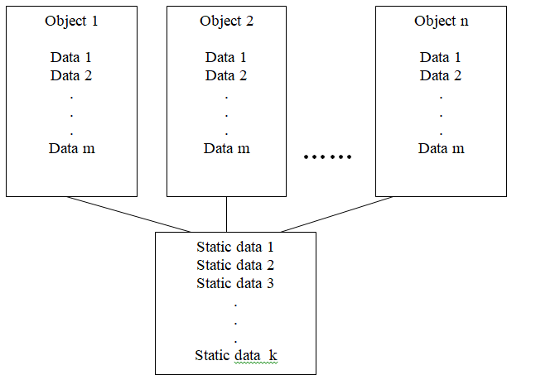
Static Data as class member

Slide 7
Static Data as class member
The type and scope of each static member variable must be defined outside the class definition. This is necessary because the static data members are stored separately rather than as a part of an object.
Since they are associated with the class itself rather than with any class object, they are also known as class variables.

Slide 8
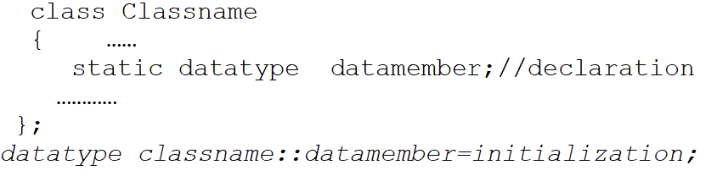
Static Data as class member

Slide 9
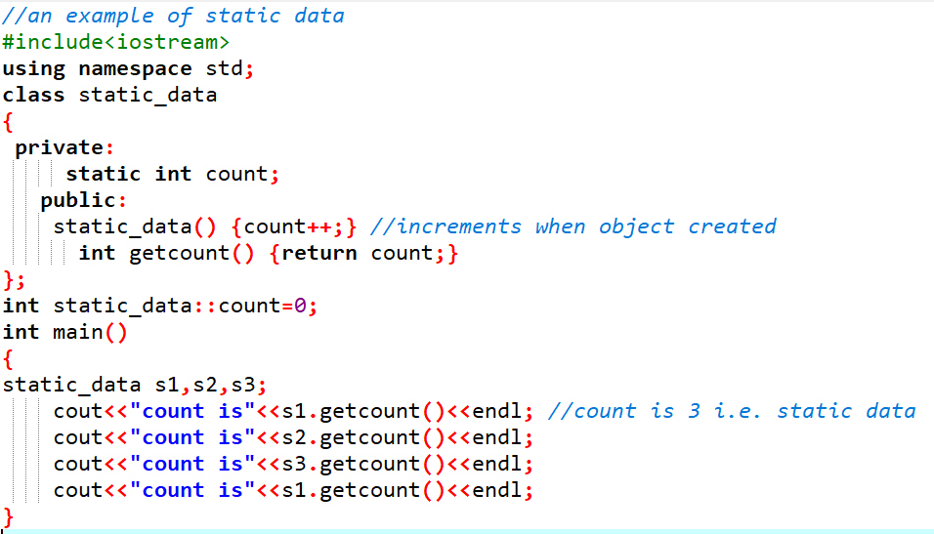

Slide 10
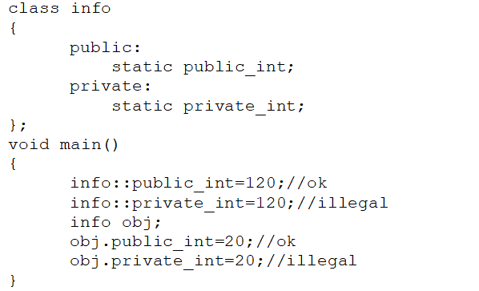
Access Rule for static data member
If data member are public static, then they can be accessed by using :: operator or member access operator through objects as:

Slide 11
Static Function
A static function is one which is declared as static in a class. A static function can access only static member data and can be accessed by using class name rather than object name

Slide 12
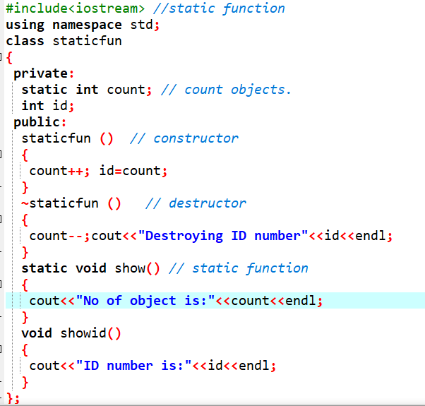

Slide 13
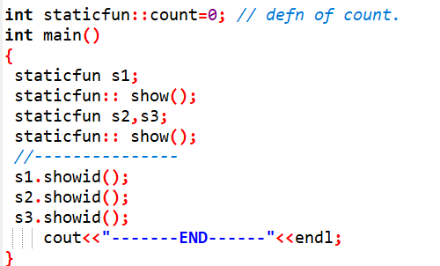

Slide 14
Object as function arguments
The object can be passed as function arguments. This can be done in three ways.
A copy of entire object is passed to the function (pass by value)
The object name is passed as reference (pass by reference)
Only address of the object can be transferred to the function (pass by address)

Slide 15
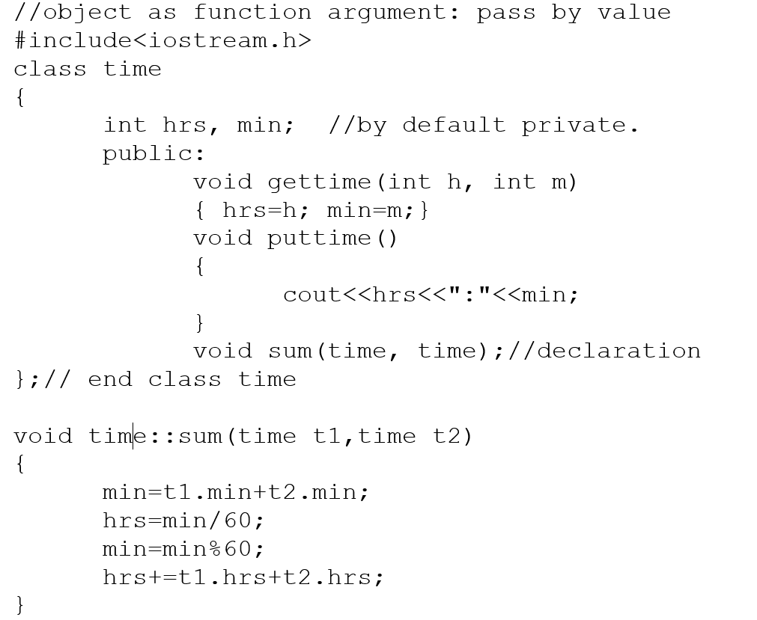

Slide 16
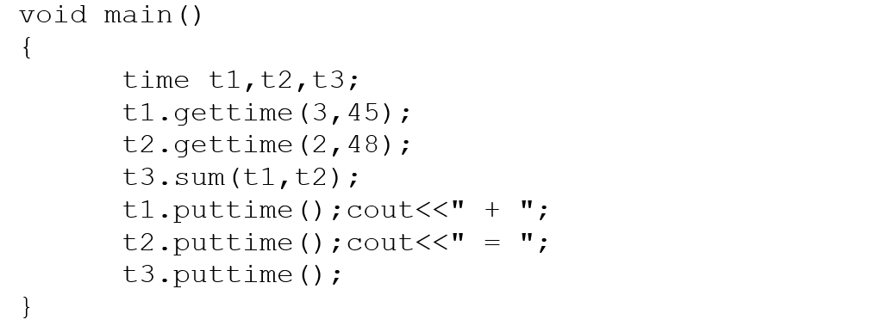
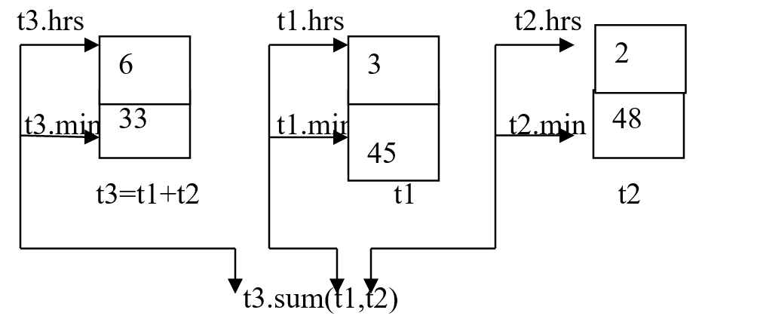

Slide 17
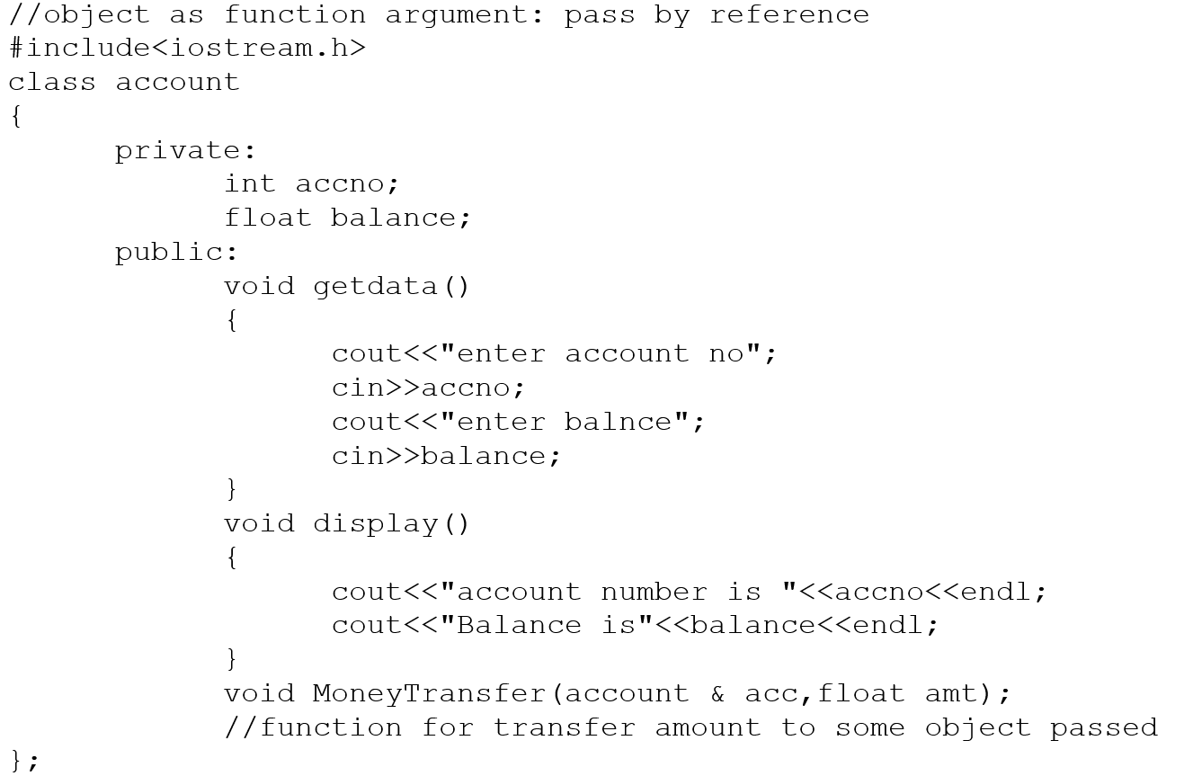
Passing objects by reference

Slide 18
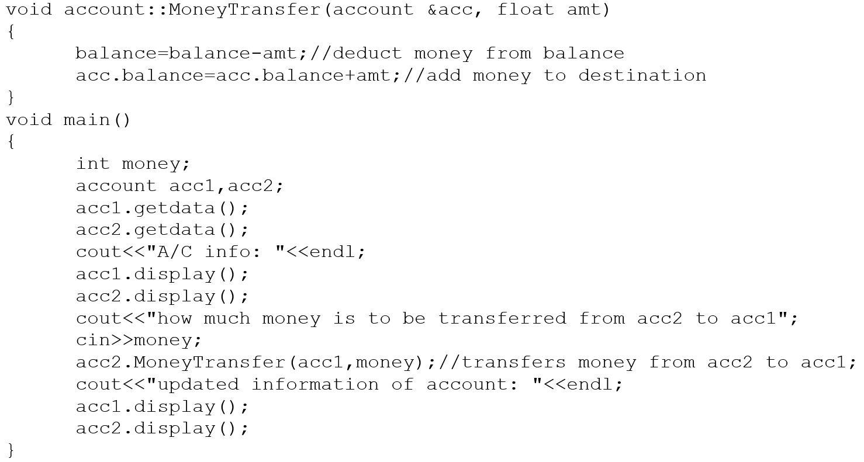
Passing objects by reference

Slide 19
Passing objects by pointer
The objects can be passed as function arguments using pointer like passing normal pointer variable.
The member of the class are accessed by using->operator if objects are passed using pointers.

Slide 20
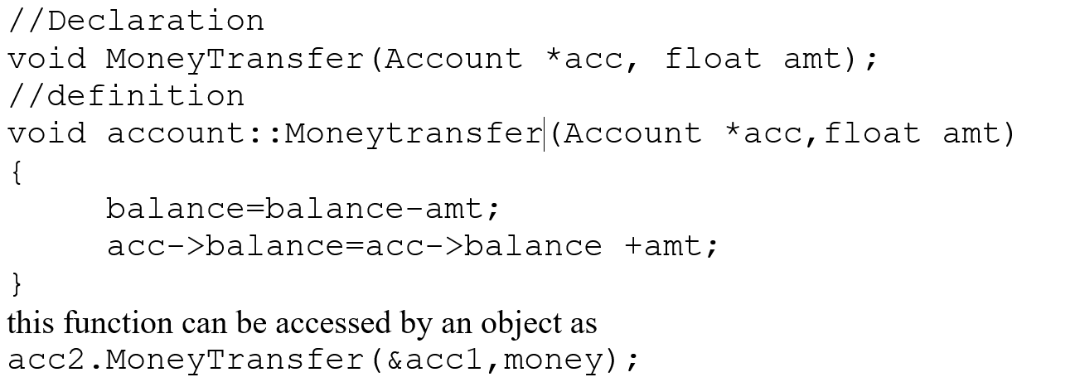
Passing objects by pointer

Slide 21
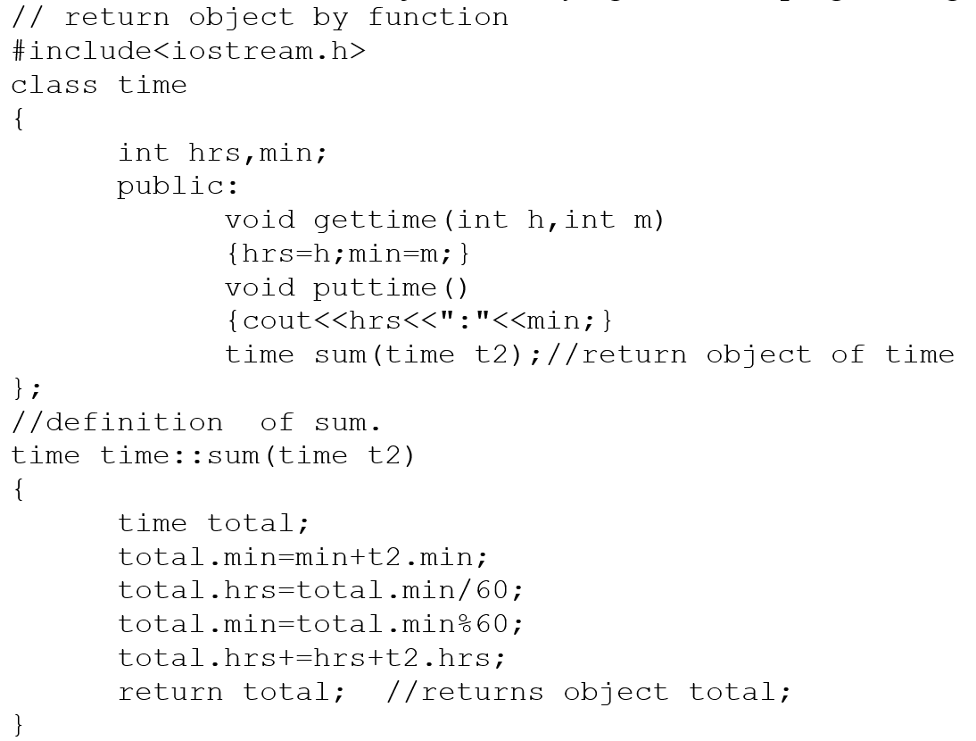
Returning Object from Function

Slide 22
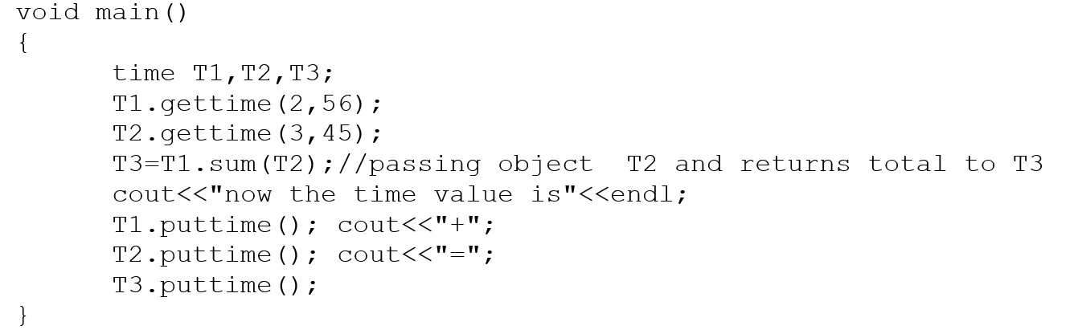

Slide 23
this Pointer
Every object in C++ has access to its own address through an important pointer called this pointer.
The this pointer is an implicit parameter to all member functions. Therefore, inside a member function, this may be used to refer to the invoking object.
Friend functions do not have a this pointer, because friends are not members of a class. Only member functions have a this pointer.

Slide 24
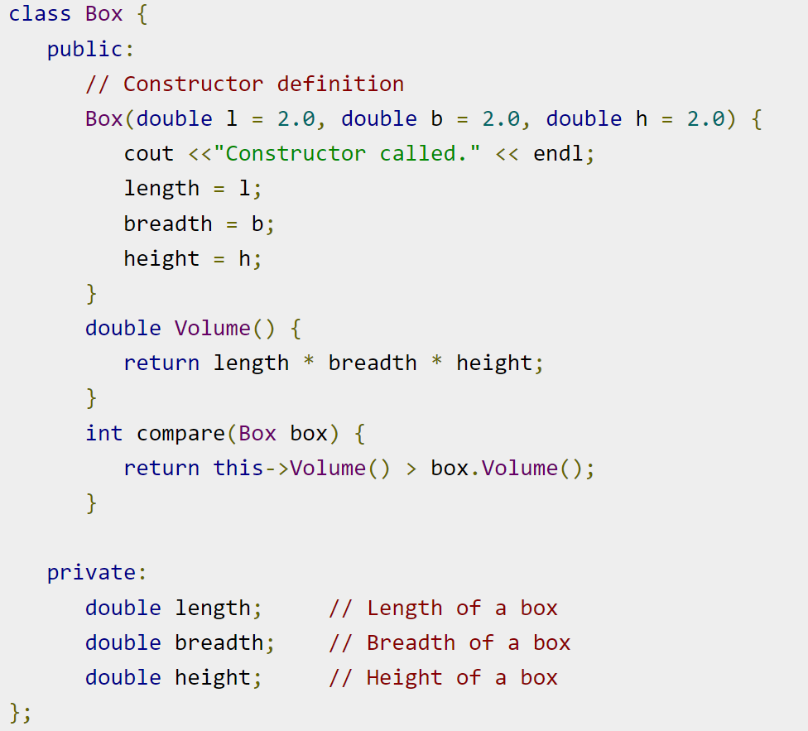

Slide 25
